Slide 1
Social Media, enhanced content and democratization of access to scientific and medical data
Dikran Toroser, PhD CMPP
Merck & Co, Inc.

Slide 2
DISCLAIMER
All opinions are the author’s and do not necessarily reflect the opinions of their present or past
employers or any professional organization

Slide 3
AGENDA
PUBLICATION TRENDS
VOLUME & SPEED!
CHALLENGE: Maintaining the SCIENTIFIC RIGOR
ENTRY POINTS TO MEDICAL DATA
CHANGING DEMOGRAPHICS of CONSUMERS
Democratization of information
CONCLUSIONS and Future State

Slide 4
Volume & Speed
Staggering Growth in Publications
(Doubling of information every 9 years since WWII¹)
Hyper-competitive environment
Publish or Perish
Share of Voice sentiment
Largest growth: Emerging markets (eg, India, China, South Korea)²
Innovation in Processes and technology to keep pace³
¹Bornmann and Mutz (2015) Growth rates of Modern Science
²AJE Scholarly Publishing Report (2016) Current Publication Trends
³Blockchain in Medical Publishing. https://www.frontiersin.org/articles/10.3389/fbloc.2019.00019/full

Slide 5
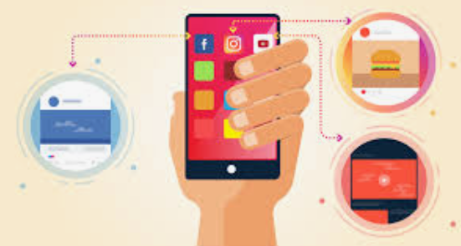
…increasing volume (continued)
Wealth of information from many outlets
EASIER ACCESS
Changing consumer demographic!
Some patients are active participants
Positive sentiment re. Pharma

Slide 6
…increasing volume (continued)
Wealth of new FORMATS for consumers
Enhanced Content
Social media
Preprints
Other
Enhanced content
https://www.thelancet.com/the-lancet-voice

Slide 7
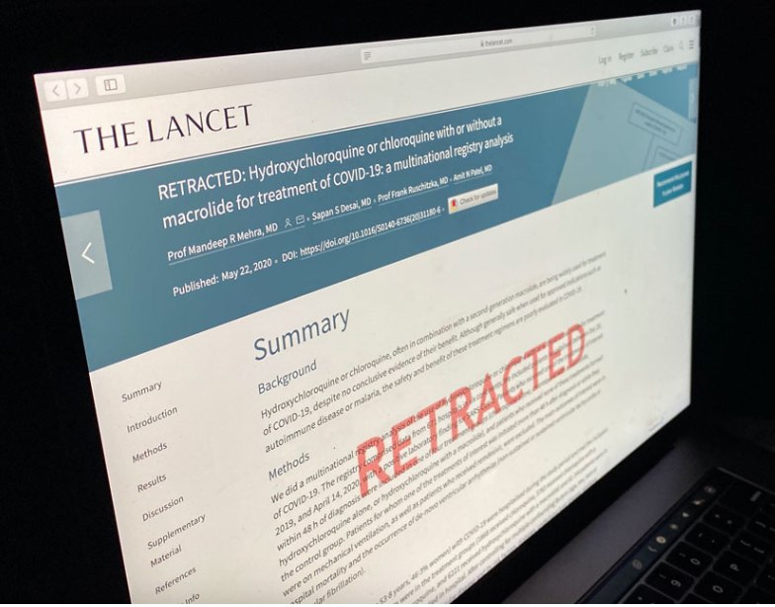
UNINTENDED CONSEQUENCES …to increasing speed & volume
Significant Quality Concerns…retractions
peer-review speed/quality
Plagiarism
publication bias
predatory publishing
cost of OA publishing/inequality
AMWA-EMWA-ISMPP joint position statement on med pubs, preprints & peer review
https://www.tandfonline.com/doi/full/10.1080/03007995.2021.1900365

Slide 8
DECENTRALIZATION
Community based
Self-Testing/Treatment (eg, COVID, HIV etc.)
Increased Access to Healthcare information
Social Media
Enhanced Content
Preprints
Increased RISK…increased disinformation
Retractions: https://www.youtube.com/watch?v=KS-mHOtXX84

Slide 9
FUTURE state is here…persistent changes
Different/enhanced ways to:
- Consume content (eg. Read)
- Generate content (eg. Work)
- Access/store scientific and medical literature
DEMOCRATIZATION
de·moc·ra·ti·za·tion
Noun
“the action of making something accessible to everyone.
"the democratization of information through technology"

Slide 10
Multiple ENTRY POINTS/Methods
Apps
Social media
Virtual sessions
Other
A paperless highly connected experience

Slide 11
RISK reduction for our “new normal”
- Professional Education: ACSE, ISMPP, AMWA, EMWA etc.
- Guidelines: (eg. GPP and EQUATOR)
https://theacse.com/
https://www.ismpp.org/
https://www.equator-network.org/

Slide 12
CONCLUSIONS and Future State
Access to information at additional entry points
Format of information rapidly changing…video, audio, graphical
Speed to the public domain is increasing rapidly
Consumer DEMOGRAPHIC changing (Democratized)
Positive public sentiment towards Pharma

Slide 13
QUESTIONS/Comments/Discussion

